Slide 1


The challenges of PPPs within the framework of best practices and international standards
Sistema de Concesiones al 2050
Edwin Lau
Head of Division
Infrastructure and Public Procurement
Public Governance, OECD
Edwin.LAU@oecd.org

Slide 2
What potential infrastructure
agenda for Chile?

Slide 3
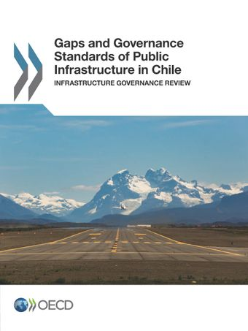
2017 OECD Infrastructure Governance Review of Chile
A key weakness identified in Chile’s governance framework is the lack of medium- to long-term infrastructure planning, particularly in the central government.
The project evaluation and prioritisation system will need to accommodate transversal issues and multiple policy goals.
Chile’s central government is characterised by a high degree of compartmentalisation.
To ensure value for money, infrastructure planners need to adopt a whole-of-life approach with sufficient capacities at each stage of the project life cycle.
Notes:
The planning system will need to develop a greater capacity for long-term thinking, decentralise infrastructure decision making, improve co-ordination within and across sectors,, and develop a more holistic approach to addressing infrastructure gaps that extends beyond supply measures to consider a wide range of policy interventions.
Project evaluation and prioritisation: Decisions regarding what to build and how to build it will increasingly need to take into account negative externalities, whether in terms of air quality, carbon emissions, or health and safety.
Compartmentalisation: Sectoral ministries work within somewhat isolated silos, with limited mechanisms for ensuring alignment and integration across policy areas and investments. The recommendation is to assess overlaps between ministries and clarify roles.
LC approach: From project preparation through execution to operation – including sufficient resources for ensuring value for money during contract modifications, renegotiations or extensions. Specifically, project leaders will need to ensure that they have sufficient capacity to effectively monitor concessions during their operational phase. As the number of projects in their operational phase increases, greater resources will be required.

Slide 4
What has changed since the OECD review in 2017?
In Chile:
Chile has established mechanisms to ensure that infrastructure strategies and plans contribute to climate mitigation strategies (e.g., NDCs, net-zero strategies, LT-LEDS): Estrategia Nacional de Electromovilidad, Energía 2050 Chile and Certificación Educación Sustentable.
2019-20 Estallido Social with calls for greater social equality
In the global environment:
Significant global macroeconomic changes since COVID-19 pandemic & the war in Ukraine:
  Normalisation of higher interest rates and non-transitory inflation
  Supply chain disruptions & greater uncertainty due to climate disasters
  Continued globalization of infrastructure actors
  Reports of declines in contractor bids leading to less competition
Re-emergence of concern for Paris and SDG agenda, following COVID-19

Slide 5





2020 OECD Recommendation on the Governance of Infrastructure
Strategic planning
Life cycle approach
Long-term strategic vision for infrastructure
Fiscal sustainability, affordability, and value for money
Efficient
and effective procurement
Stakeholder participation
Co-ordination across levels of government
Procurement
Stakeholder participation
Regulatory framework
Management
of threats
to integrity
Evidence-informed decision making
Life cycle performance
Critical infrastructure resilience
Notes:
The Recommendation was adopted by the OECD Council in July 2020.
It provides countries with practical guidance for efficient, transparent and responsive decision-making processes in infrastructure investment.
It supports a whole-of-government approach and covers the entire life cycle of infrastructure projects, putting special emphasis on regional, social, gender, and environmental considerations.

Slide 6
Delivering sustainable infrastructure

Slide 7
Going Net Zero will require infrastructure investments in alternative energy, efficiency and changes in consumption
Average annual clean energy investment and financing in the Announced Pledges and Net Zero Emissions by 2050 scenarios
Clean energy investment climbs to USD 4 trillion by 2030 in the NZE, with most growth in emerging and developing economies. Globally 70% is financed by private actors; public finance plays a critical catalytic role and in networks.
Source: IEA (2020)
Notes:
There is a USD 2.5 – 3.5 trillion infrastructure investment gap (over 4 years) to deliver net-zero goals and SDGs
The Announced Pledges Scenario (APS), introduced in 2021, illustrates the extent to which announced ambitions and targets can deliver the emissions reductions needed to achieve net zero emissions by 2050.

Slide 8
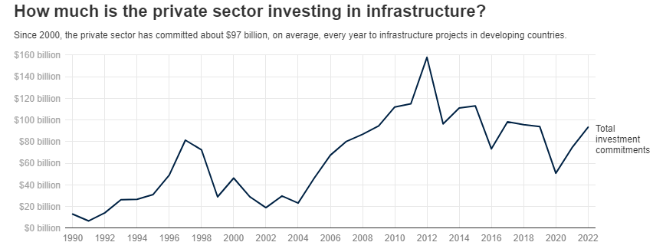
Need for scaling up private investment in sustainable infrastructure
Source: World Bank, 2022 PPI Annual Report
  Main bottlenecks: poor quality and non-standardised data, risk allocation and incentives
  Challenging context: rising interest rates, uncertain supply chains
  Reputational risk: increasing demand for sustainable & quality infrastructure projects
  Infrastructure investment gap needs to be closed by improving targeting and performance of public investment as well as attracting private investment.
Notes:
Uncertainty
The need for greater risk-adjusted returns in the face of rising interest rates

Slide 9

Challenges for investment in sustainable infrastructure
Traditional planning and decision-making frameworks and instruments for infrastructure investment are ill-adapted for accommodating multiple objectives.
Uncertainties arising from rapidly changing environments create a challenge for long-term infrastructure planning.
Governments have a strong incentive to prioritise infrastructure investments with high visibility resulting in short-sighted investments.
Multi-level governance is required to plan and deliver on sustainable infrastructure.
Notes:
Inadequacy of traditional frameworks and tools: This is so particularly when these extend beyond the direct benefits for users to encompass broader outcomes relating to the environment, such as climate change mitigation, cleaner air, and biodiversity preservation.
Uncertainties arising from factors such as rapidly evolving technologies, the impacts of climate change and behavioural changes in society create a challenge for planning infrastructure assets with lifetimes that span decades. Insufficient flexibility, responsiveness and poorly targeted procurement strategies can lead to dated or carbon-intensive technologies encroaching into long-term infrastructure contracts and agreements.
Short-sighted investments: Especially amidst an economic and social crisis, the risk of selecting projects that deliver the most benefits in the short-term but that do not adequately address long-term sustainability targets is higher than ever.
Multi-level governance: An infrastructure project does not exist in a vacuum, but it is rather part of a network of multiple infrastructure assets that are interlinked and cross different jurisdictions. Therefore, governing infrastructure is generally challenging as it requires to co-ordinate and co-operate across different administrations, and it becomes even harder when addressing climate change, considering that its impacts and risks are perceived differently across spaces.

Slide 10
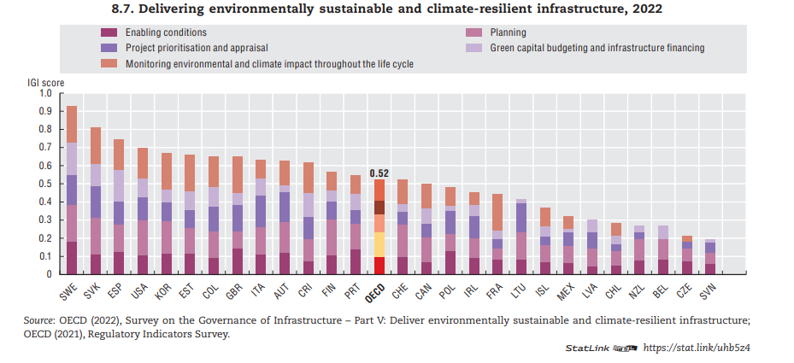
Chile could do more to incorporate climate considerations into its infrastructure planning & delivery
  NOTE: These data are based on transport sector only.
Notes:
Need to develop key enablers for the implementation of broader government sustainability initiatives (e.g. circular economy, net-zero carbon emissions, sustainable mobility).
High level targets in place, but missing the criteria to operationalise these goals and targets into project appraisal criteria.
In Chile, the Environmental Impact Assessment is not used to inform project selection and prioritization (compared to 68% (19 out of 28) of OECD countries that systematically use the results of the EIA to inform project selection and prioritisation).
Chile does not require a climate impact assessment to estimate a project's potential emissions. 63% of OECD countries (17 out of 27) require a climate impact assessment to estimate the potential emissions of a transport infrastructure project, 44% (12 out of 27) systematically use the results to select or prioritise projects.
In Chile, climate change adaptation measures are not required to be integrated into the design of transport infrastructure projects, nor are climate resilience criteria are used to inform project section and prioritization. 46% of OECD countries (12 out of 26) require climate change adaptation measures to be integrated into the design of transport infrastructure projects. 35% (9 out of 26) systematically use climate resilience criteria to inform project selection and prioritization.
OECD project with Ireland.

Slide 11
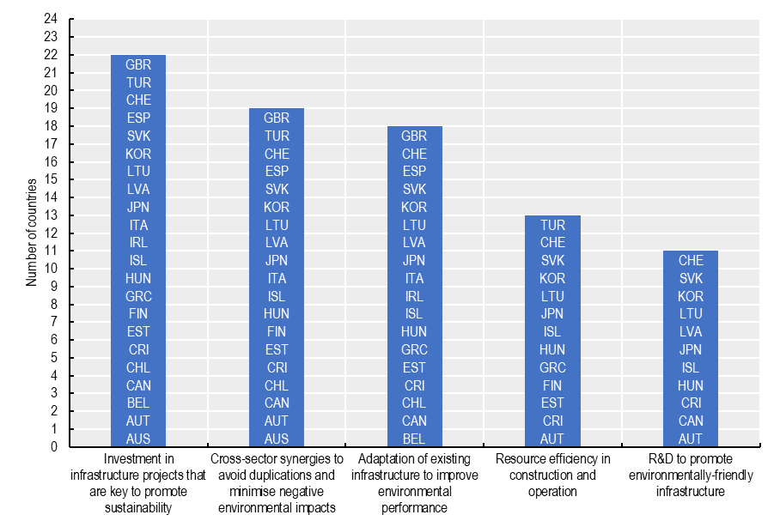
Chile has established goals and targets in the infrastructure plan to promote sustainable infrastructure
Source: 2020 OECD Survey on the Governance of Infrastructure
Notes:
More alignment is needed in terms of ensuring an environmentally sustainable implementation of projects, both through resource efficiency or R&D to promote more sustainable infrastructure design, construction and operation

Slide 12
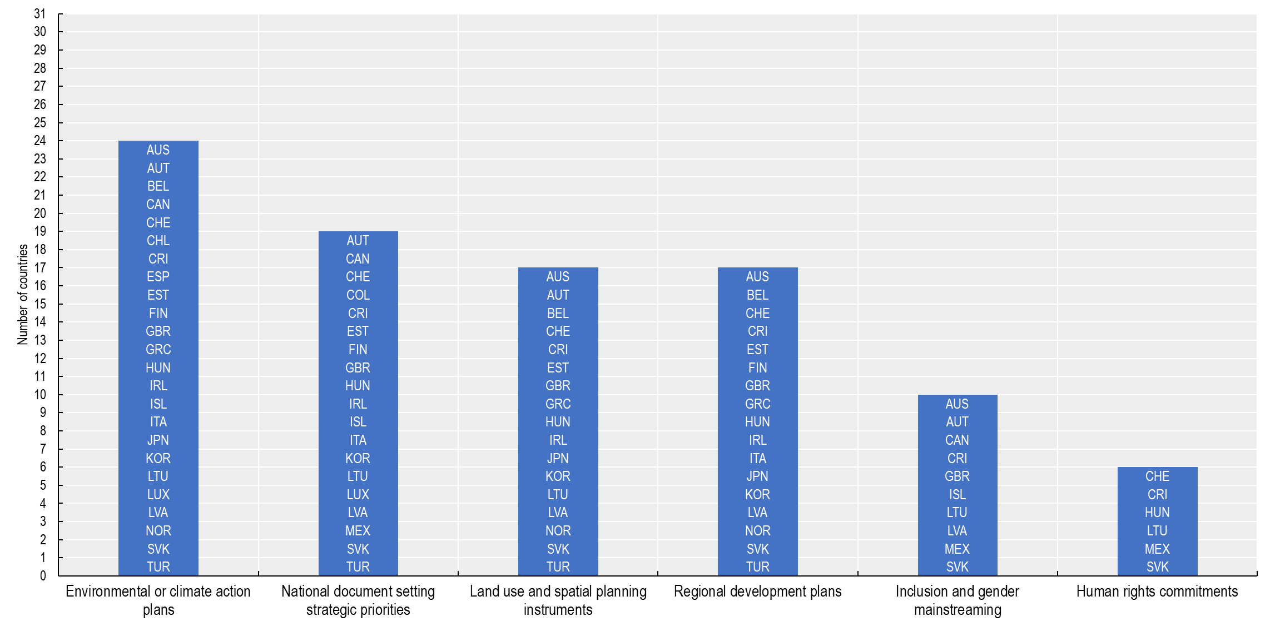
Chile has aligned its infrastructure plan with environmental and climate action plans
Source: 2020 OECD Survey on the Governance of Infrastructure
Notes:
Investments in upgrading and retrofitting existing infrastructure are in line with growing concerns on infrastructure resilience following the COVID-19 crisis

Slide 13
Governance for sustainable infrastructure investment
2) Better governance to strengthen efficiency, fight corruption & build citizen trust
3) A project pipeline that attracts innovative & sustainable financing
4) Multi-level governance for sustainability & addressing regional imbalances
1) Green & resilient infrastructure for Sustainable & Inclusive Growth
A strategic, long-term approach to infrastructure to respond to climate change. Infrastructure choices lay the framework for the energy transition & influence consumption. Taking lifecycle costs into account strengthens investment in quality infrastructure, improves resilience and incentivizes maintenance.
Infrastructure governance improves spending and delivery by integrating high-level commitments, improving coordination and policy coherence, and balancing short- and long-term interests.
Good infrastructure governance attracts private investment by improving project selection and management, reducing waste, and improving risk assessment.
Public investment has long-term consequences. Infrastructure investment in today’s economic recovery packages will shape transportation, energy, land use, regional development and much more for a generation.

Slide 14
Strengthening value for money and social legitimacy

Slide 15
Infrastructure governance for project bankability and social legitimacy
Strategic vision: Operationalising national plans into project appraisal criteria for a pipeline of investable projects
  Clear & predictable government plans for reaching NETZERO, including the required infrastructure investment
  Integrating environmental & social considerations into cost-benefit analysis
Ensuring delivery capacity
  Responding to increased uncertainty with new approaches to public-private collaboration and evidence-based contracting
  Ensuring the needed public sector skills for project preparation, contract management and infrastructure procurement
Dialogue between public & private sectors (and citizens!) on sustainability outcomes to align the expectations and to increase clarity, transparency & trust
  Reducing investor uncertainty through more standardised and transparent project reporting
  Demonstrating access & value for money to users
  Strengthening the acceptability & legitimacy of investments
Project Capacity, Alignment & Delivery
Sustainablility
Strategic Vision
Notes:
Investing in Canada
Canada’s long-term infrastructure Plan
5 areas for investment: Public Transit; Green Infrastructure; Social Infrastructure; Trade and Transportation Infrastructure; and Rural and Northern Communities
Investing in Canada Plan (https://infrastructure-toolkit.oecd.org/wp-content/uploads/Canada_Plan.pdf)
Project Ireland 2040
Ireland’s long-term overarching strategy for a more resilient and sustainable future
Ensures the alignment of investment plans with the stated National Strategic Objectives for 2040
Project Ireland 2040 (https://www.gov.ie/en/campaigns/09022006-project-ireland-2040/?referrer=http://www.gov.ie/2040/)

Slide 16
What PPP and concessions framework is required?
Next year, the OECD will begin updating its 2012 Recommendation on PPPs to focus on key issues such as the value for money and risk allocation:
A continuous concern for PPPs and traditionally financed major projects alike has been an insufficient competition (Roumboutsos, 2019).
Large contracts based on fixed price (the very same PPPs rely on) are becoming untenable due to the contractor’s exposure to high-impact low-probability (or HILP) risks or colloquially uncertainty, leading to market exists (2023 OECD expert meeting on construction risk management in infrastructure).
The trust in PPPs as a procurement tool is challenged because countries were unable to defend the choice for PPPs on a value for money basis (and also because of integrity failures).
One of the major foundations on which the PPPs were supposed to deliver value for money are challenged, i.e., the presence, sustainability, and the effectiveness of competition for major projects, which is directly related to the risk allocation in PPPs.
OECD countries have mandated independent institutions (e.g. economic regulators or supreme audit institutions) to carry assessments of the PPP programs and highlight the main pitfalls and ways forward

Slide 17
A holistic risk management framework:
OECD Support Tool for Effective Procurement Strategies (STEPS)
A one contract for a project (= one-size-fits-all risk allocation) is easy to administer, but not efficient
DBB with schedule of rates
A collaborative delivery model
DB contract
Hold-up risk
Persistent post-contract uncertainties causing hold-up risk
Competition failure risk
Notes:
Network of professionals in Inrastructure Delivery

Slide 18
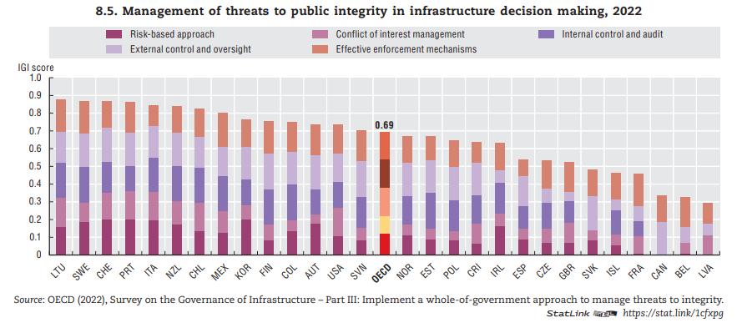
Integrity is key to build trust in PPPs
Notes:
Chile has good governance arrangements in place to ensure internal and external control, management of conflict of interest and integrity risks and enforcement mechanisms. However, the country could better promote a risk-based approach to managing threats to integrity.
Within the last five years, Chile has not prepared or published an analytical report on public integrity risks in infrastructure management (42% or 11 out of 26 OECD countries have published such a report).
In Chile, major infrastructure undertakings are not backed by an assessment of public integrity risks (46% or 12 out of 26 OECD countries assess public integrity risks for all or at least for major infrastructure projects).

Slide 19
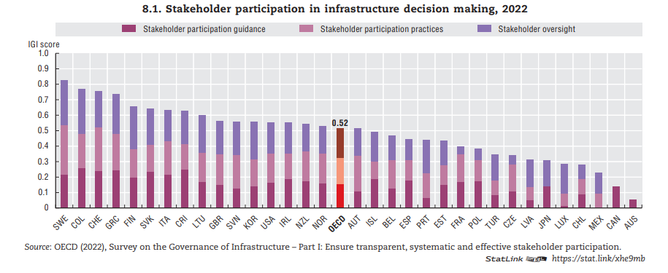
Chile could further promote stakeholder participation in infrastructure decision making
Notes:
Chile does not have mechanisms for stakeholders to engage on spatial planning and its relation with infrastructure development (87% or 27 out of 31 OECD countries have developed such participatory mechanisms).
To ensure that stakeholder participation is systematic and effective, countries can provide central guidance on how to design, implement and evaluate such processes. Chile does not have a national guidance on stakeholder participation. Most OECD countries have adopted such type of guidance (27 out of 33, or 82%). 24% (8 out of 33) of them have guidance specific to infrastructure or sectors.
In Chile, there is no role for stakeholders in the oversight and monitoring of public infrastructure such as through participation in procurement, assessing and mitigating the risks of corruption, etc. (53% or 17 out of 32 OECD countries give stakeholders such a role).

Slide 20
Example of an early adopter of concessions -- Transport Regulatory Agency in France (ART)

Slide 21
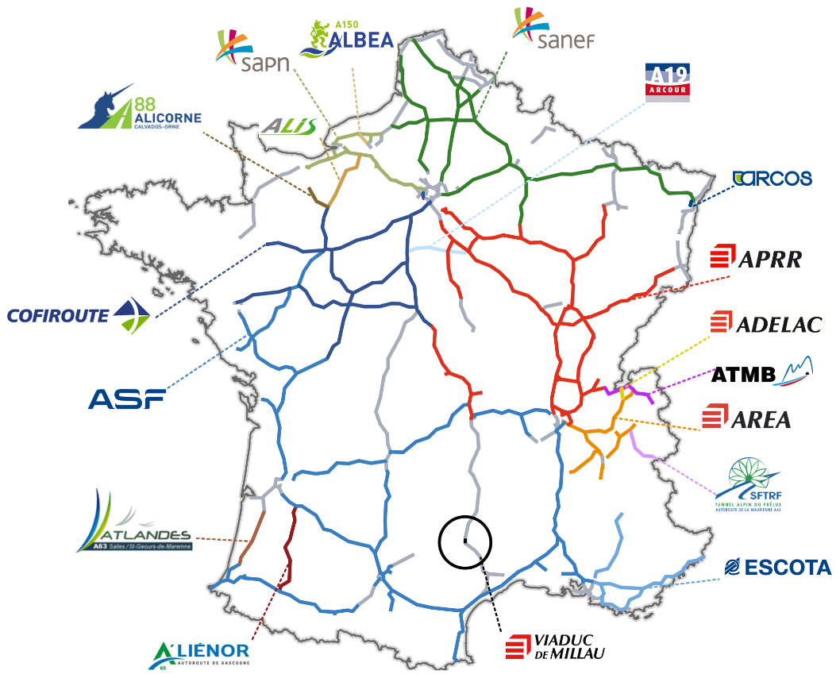
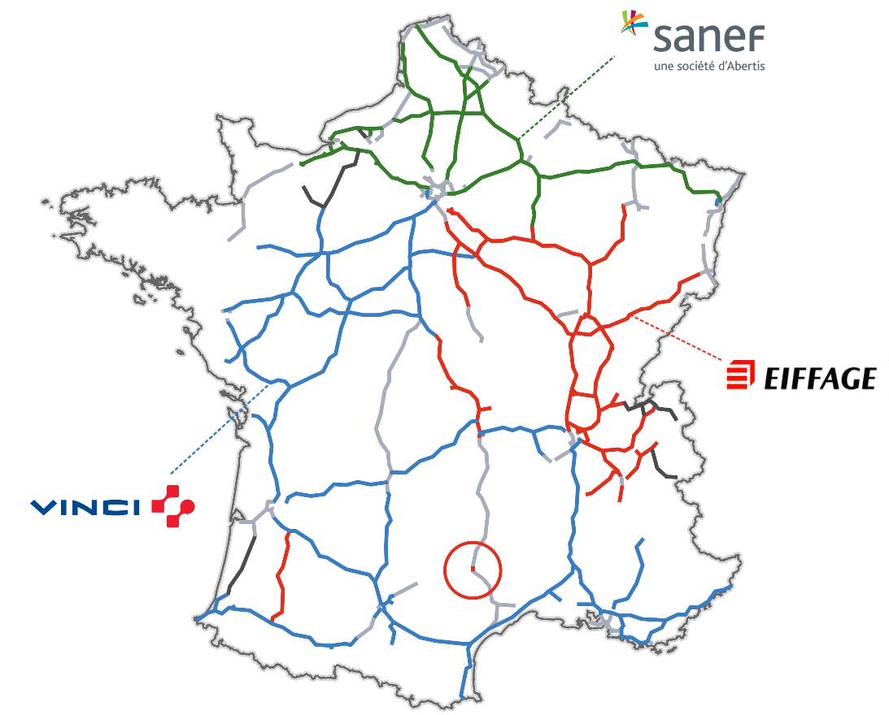
The French motorway sector: The motorway concession companies
Over 75 % of the French motorway network is conceded to 20 motorway concession companies
(but behind them are just 3 major players so competition is a problem)
A French concession contract is a Private Public Partnership that has three features : (i) it is a global contract ; (ii) It based on user-pay principle ; (iii) it is long term contract
21
Notes:
An interesting example for Chile will be the reascent assessment done by the Transport Regulatory Agency in France (ART). ART plays a unique role in shedding light on the economics of motorway concessions.
In 2020 ART developed a report to provide explanations on a concession model that has been highly criticised
In 2023 ART prepared a report to open the debate on the future of the concessionary motorway network (2031-2036).

Slide 22
France will examine three aspects of of the current model in view of the expiry of the historical contracts in 10 years’ time
1
2
3
ANALYSIS N° 1
ANALYSIS N° 2
ANALYSIS N° 3
Regarding risk-sharing arrangements
Concerning the geographical and temporal scope of contracts
On the modalities for revising contracts
Before launching new tenders, an analysis of each model should be conducted, particularly with regard to the transfer of traffic risk
Consideration should be given to the appropriateness of a geographical redistribution of concessions
Reducing the duration of concessions is desirable and possible in future contracts
A five-year review would make it possible to revise the parameters negotiated in the context of amendments and to systematize cost and opportunity studies
Notes:
Three aspects of of the current model need to be re-examined in view of the expiry of the historical contracts:
Risk arrangement: before launching new tenders, an analysis of each model should be conducted, particularly with regard to the transfer of traffic risk
Regarding geography and duration: Consideration should be given to the appropriateness of a geographical redistribution of concessions and reducing the duration of concessions is desirable and possible in future contracts
On the modalities for revising contracts: A five-year review would make it possible to revise the parameters negotiated in the context of amendments and to systematise cost and opportunity studies

Slide 23
The options for the next stage of motorways concessions in France
The state takes over the concessions after expiry in a SoE regulated model.
The existing concession model is amended (shorter concessions, get better at benchmarking so renegotiations do not lead to rent capture)
The existing model is amended , and concessions are broken down to sections of 300km in length (a massive boost to competition for the contract; but at the expense of three big French incumbents)

Slide 24
Blue Dot Network

Slide 25
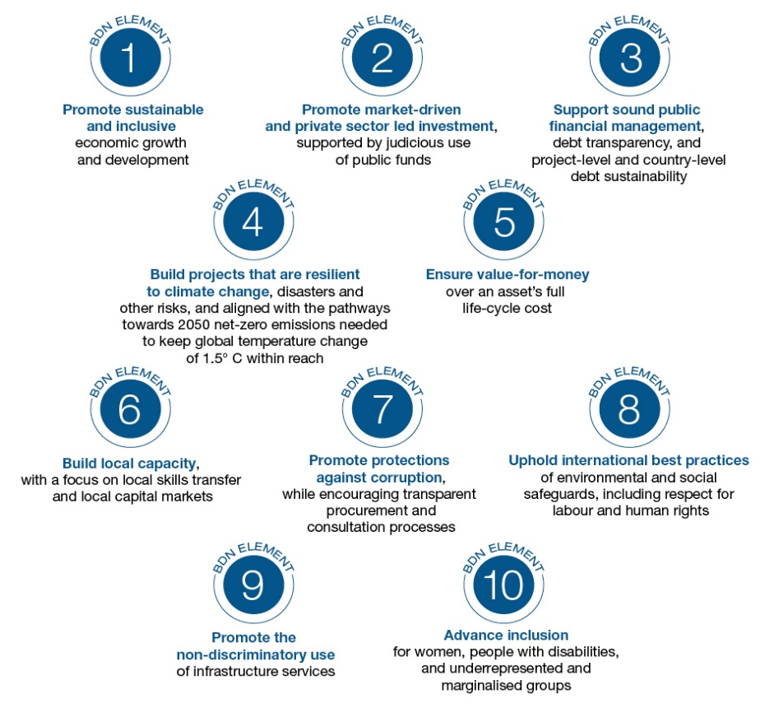
Blue Dot Network: improving information on quality infrastructure investments for investors and citizens
What are the aims of the Blue Dot Network?
Provide a trusted signal to investors, communities and other stakeholders that a project is aligned with internationally-agreed standards of quality infrastructure investment and has addressed a number of key risks.
Streamline and synthesise standards to make infrastructure development more efficient.
Promote infrastructure investment in developing and emerging economies in concert with global initiatives that share similar values such as PGII and Global Gateway.
Who is Blue Dot Network for?
The Blue Dot Network certification is an inclusive framework open to infrastructure projects across all major infrastructure sectors in both developed and developing economies.

Slide 26
Benefits of the Blue Dot Network for stakeholders
Help identify investable projects
Provide reassurance that key risks have been addressed
Facilitate due diligence
Improve data availability
Create a global level playing field
Streamline ESG standards and reporting
Meet requirements of major financing institutions
Assist in raising financing
Investors
Contractors and project developers
Communities
Governments
Local economic development
Access to quality infrastructure services
Improvements to well-being
Local jobs
Avoidance of harm to communities and the environment
Achieve sustainable development and climate goals
Attract private investors
Ensure projects deliver value for money
Avoid negative impacts on communities

Slide 27
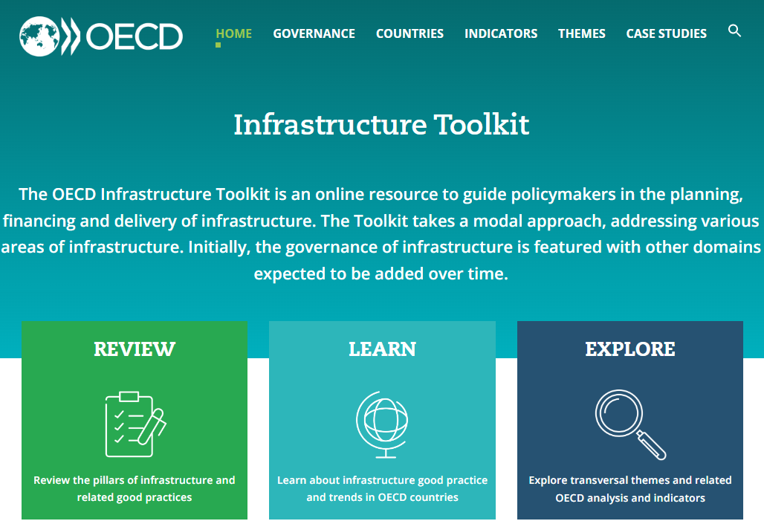
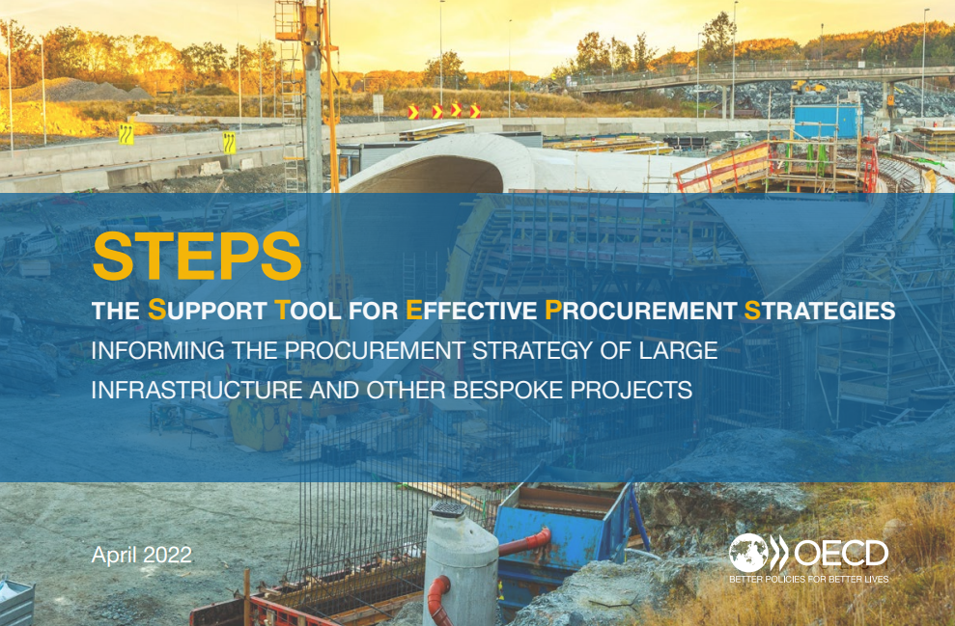
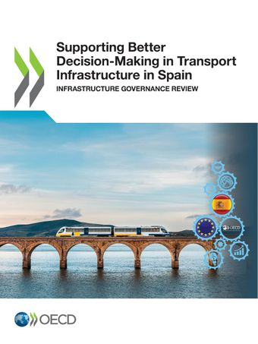
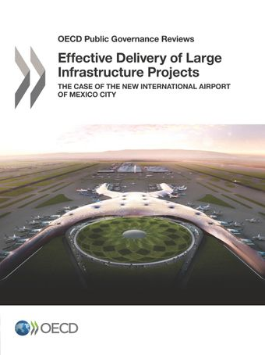

OECD resources for improving infrastructure planning & delivery

Slide 28

For more information, please contact:
Edwin Lau (Edwin.LAU@oecd.org)

Slide 29
Towards a holistic risk management framework – going beyond STEPS
Which is the right option and stakeholder management issues
Unhappy stakeholders can force changes to the project scope later=> causes problems in execution
Market structure - capabilities data
(competition issues at what activity)
Category managers checking supply chain
Delivery entity
(capabilities organisation, leadership, …)
Planning/ appraisal and value distribution
Standard Initial detailed risk analysis
(the tech. reasons)
STEPS
(the commercial implications)
Execution of procurement strategy
Iteration of solutions
Using AI to predict procurement failures…
Repository of post contract procurement failures from all projects

Slide 30
VfM process more likely for PPP relative to traditional infrastructure projects
Formal process/legal requirement to demonstrate value for money in infrastructure projects
PPPs
TIPs
Notes:
As the number of social and environmental objectives increase, project managers will have to become more skilled in balancing multiple objectives. One way to support this is to provide tools and guidance: UK's multi-criteria analysis manual
Guidelines for Government officials and other practitioners on the incorporation of MCA in decision making processes
Explains techniques that do not necessarily rely on monetary valuations as a way to complement the use of monetary methodologies (e.g., CBA, cost-effectiveness analysis)
Multi-criteria analysis manual (https://infrastructure-toolkit.oecd.org/wp-content/uploads/UK_MCA.pdf)

Slide 31
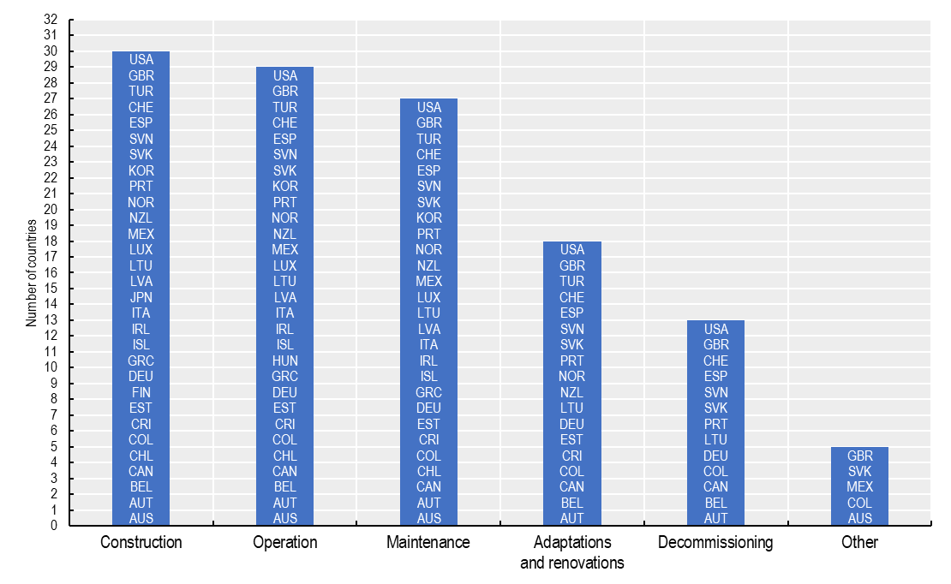
Chile would benefit from a life cycle approach to project appraisal and selection
Costs estimated to assess affordability of new infrastructure projects, 2020
Source: 2020 OECD Survey on the Governance of Infrastructure
Notes:
Evaluation of asset performance in Austria
Network Condition Report published annually, presenting the overall asset performance of the rail network
The results of this evaluation form the basis for the planning of re-investments and maintenance
Evaluation of asset performance in Austria (https://infrastructure-toolkit.oecd.org/wp-content/uploads/Austria_AssetPerformance.pdf)

Slide 32
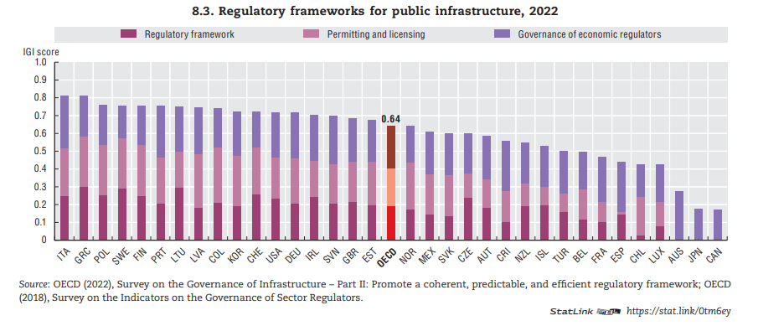
Are regulatory frameworks fit for purpose for timely and sustainable infrastructure delivery?
Notes:
Permitting and licensing can be a significant obstacle for the delivery of infrastructure.
Good practices for smart regulation suggest both: Reviewing the stock of regulations (to clean it) and establishing ex ante impact assessments for the flow of regulations (i.e. Regulatory Impact Assessment). Today, basically all OECD countries use RIA in different forms.
In Chile, there is no formal review of existing regulations relevant to infrastructure (24% or 8 out of 33 OECD countries have systematic reviews; 67% or 22 countries conduct reviews on an ad hoc basis).
There is also no formal review of the stock of licenses and permits in Chile (41% or 13 out of 32 OECD countries have systematic reviews; 44% or 14 countries conduct reviews on an ad hoc basis).
Likewise, administrative simplification can be used to streamline permitting, reducing the burdens for businesses while safeguarding public interests (i.e. construction safety, civil protection, etc.). Digital technologies can be very effective for simplification purposes (i.e., e-processing, one-stop shops, etc.).
There are no mechanisms in Chile to co-ordinate between the different regulatory bodies competent for infrastructure, either in the regulatory approval and design process (64% or 21 out of 33 OECD countries have such mechanisms) or in the implementation of regulations and services (e.g. licensing/permitting* procedures, regulatory inspections and enforcement) (61% or 20 out of 33 OECD countries have such mechanisms).

Slide 33
Chile could strengthen its infrastructure integrity framework by adopting a risk-based approach
Austria, Colombia, Italy, Korea, Portugal, Switzerland
Finland, Ireland, Lithuania, Slovak Republic, Slovenia, Sweden
Estonia, Mexico, New Zealand, Poland, United States
Belgium, Czech Republic, France
Canada, Chile, Costa Rica, Iceland, Japan, Latvia, Norway, Spain, United Kingdom
Notes:
Bad experiences from the past (i.e., corruption scandals, poor service levels, etc.) in LAC fuel lack of trust in PPPs.
Indeed, integrity risks are present in the whole life cycle of infrastructure:
Planning and design: Capturing infrastructure officials to opt for works that do not demonstrate public value, but benefit specific private interests.
Tendering: Favouring specific bidders, even when their bids do not offer the best value for money.
Contract management: Tolerating poor service levels, below contractual specifications.
The assessment of integrity risks in infrastructure should be part of a preventive approach.
A risk management strategy should be developed from the conception of infrastructure projects, as some of them will certainly materialise.
Institutionalising risk management, including a dedicated risk management function, risk management strategy and periodic risk assessments, is critical for effectively safeguarding integrity in infrastructure projects.
Risk assessments support management in effectively identifying potential irregularities and inefficiencies up front, and therefore manage project resources and operations more effectively. It is critical that the risk management strategy and risk assessments have an explicit focus on corruption and fraud risks, with a view to linking integrity policies and controls to the objectives of the project.

Slide 34
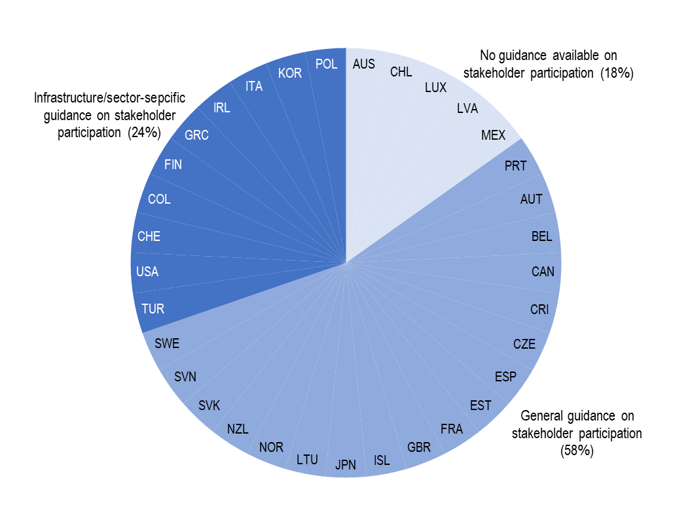
Guidance on stakeholder participation
Existence of a national guidance on stakeholder participation, 2022
Source: 2022 OECD Survey on the Governance of Infrastructure
Notes:
Chile also reports not having mechanisms for stakeholder guidance in spatial planning or for stakeholder oversight and management of public infrastructure projects.
While it does have mandatory consultation of underrepresented groups, there is no required public disclosure of how consultations are used.

Slide 35
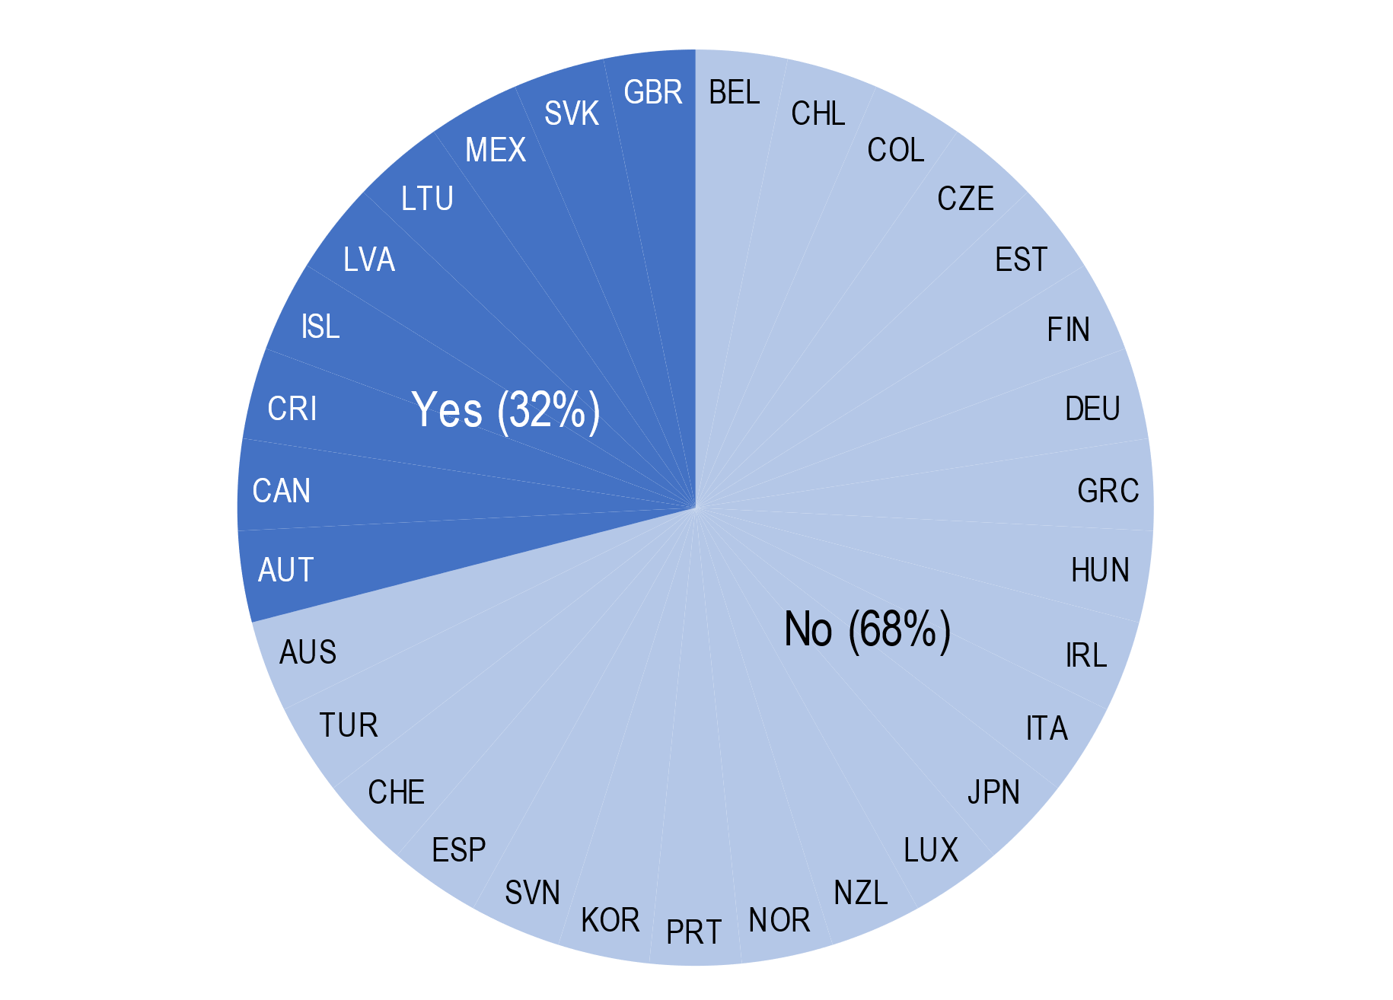
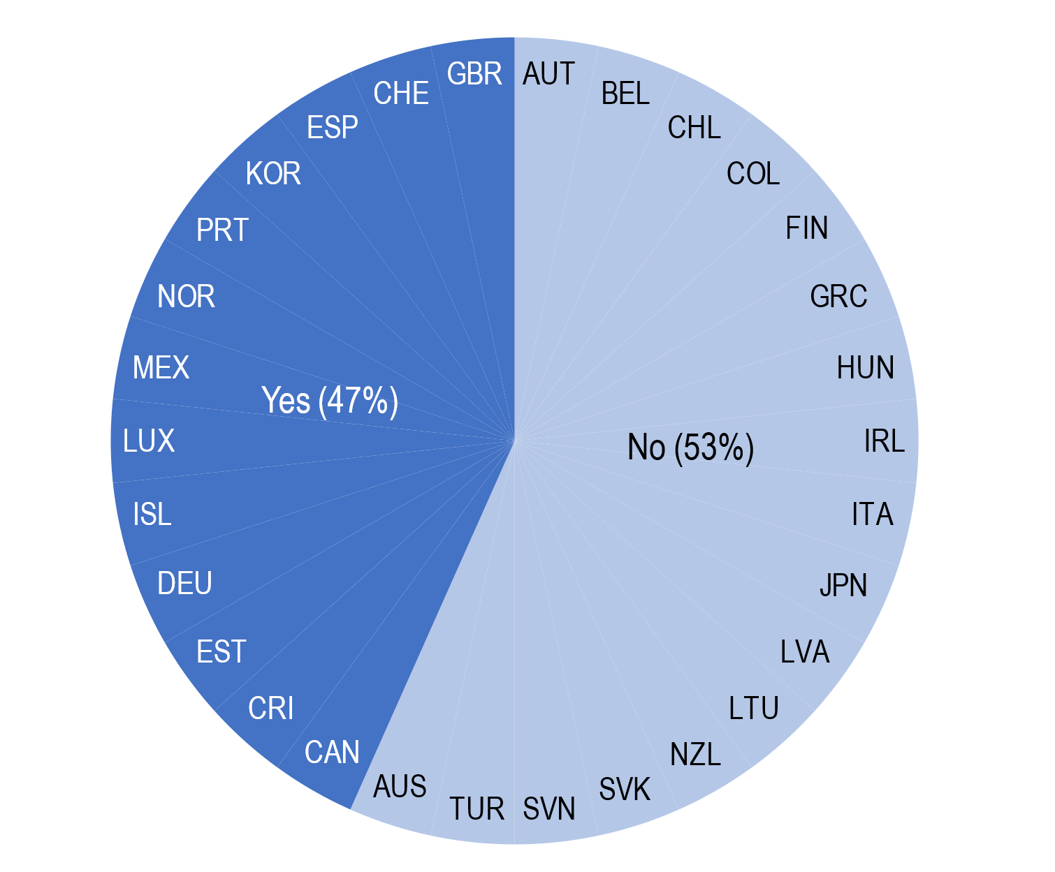
Chile’s infrastructure planning and procurement could integrate better gender and inclusion considerations
Alignment of the infrastructure plan with inclusion and gender mainstreaming policies, 2020
Provision of support to the procurement workforce on how to promote gender equality in infrastructure procurement, 2020
Source: 2020 OECD Survey on the Governance of Infrastructure
Notes:
This is particularly important given Chile’s high-levels of inequality (Gini index of 44.9, according to the WB).
Infrastructure can have a major impact on women’s access to resources and agency over their well-being, and thus on women’s empowerment.
Infrastructure itself is not gender-neutral: women and men have different needs and use infrastructure differently given their specific social roles, economic status or preferences.
Poor infrastructure quality also poses differentiated threats to women’s safety and well-being.
For example, recent studies have found that longer commutes increase the probability of leaving a job for both men and women, albeit the effects are greater for women. Women who have an hour-long commute are 29.1% more likely to leave their current job than if they had a 10-minute commute, compared with 23.9% for men.

Slide 36



What do we do ?
ART’s concrete action in the motorway sector
ART regulates motorway companies for the direct and indirect benefit of users
ART monitors the procurement procedures implemented by concessionaires for construction works, materials and services
selects
Suppliers
supplies
economic regulation for the indirect benefit of users
Upstream markets
tariff regulation for the direct benefit of users
Motorway company
Operators of motorway service areas
ART monitors the procurement procedures implemented by concessionaires for the operation of service areas
State
Downstream markets
Related markets
ART issues an opinion on the evolution of toll tariffs when contractual amendments are made and when new concession contracts are awarded
ART verifies that a criterion relating to fuel price moderation is applied to select the applicant
Users

Slide 37
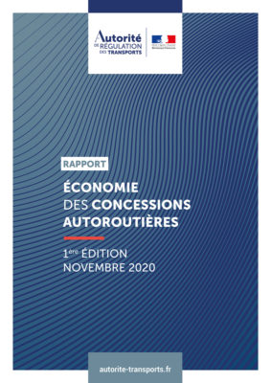
What do we do ?
ART’s reports on the economics of concessions
ART plays a unique role in shedding light on the economics of motorway concessions
2020
To provide explanations on a model that has been highly criticised
2023
Open the debate on the future of the concessionary motorway network (2031-2036)

Slide 38

Three aspects of of the current model need to be re-examined
in view of the expiry of the historical contracts
1 - One question deserves to be asked: who should bear the traffic risk?
  … users?
  … the State?
Traffic risk carried by…
  Private-public partnership & toll varying according to the traffic
  Private-public partnership & trafic-independent toll
  Higher tolls if traffic is low, and
  conversely inefficient use of
  infrastructure
  State budget burdened in times of
  recession, and vice versa
  … the contract holder?
If assessed in a competitive framework, these costs should be limited
  Concession
  Tolls incorporating the concessionaire's risk-bearing costs less use of the infrastructure

Slide 39



Three aspects of of the current model need to be re-examined in view of the expiry of the historical contracts
2 – The scope of the contracts should be reduced
  The size of concessions should remain sufficient to maximise scale effects
  However, reducing the geographical scope of concessions would limit barriers to entry when contracts are reallocated
The current model is characterised by long duration contracts, which implies:
Impossibility of regular re-tendering
Inevitably, new needs emerge during the course of the contract
Necessary negotiations with the incumbent, who is in a strong position
The duration of future contracts should be shorter than that of current contracts: considering the constraints on road management, a contractual duration of around 20 years would be relevant
One solution for reconciling the possibility of major investments and short contracts is the payment of a balance by the incoming contract holder to the outgoing contract holder

Slide 40

Three aspects of of the current model need to be re-examined
in view of the expiry of the historical contracts
3 – Contract review procedures should be improved
In the current framework:
Financial parameters of the amendments are never reviewed although they are established outside any competitive procedure
Investments are made on the basis of rudimentary cost and opportunity studies
Competitive tendering is the only case in which the concessionaire has no market power
As is already the case today, the parameters resulting from the competitive bidding process should not be revised during the course of the contract (except through the effect of mechanical clauses from the initial contract)
Strengthening regulation by regularly (e.g., on a five-yearly basis):
reviewing the negotiated parameters
systematising cost and opportunity studies

